Slide 1
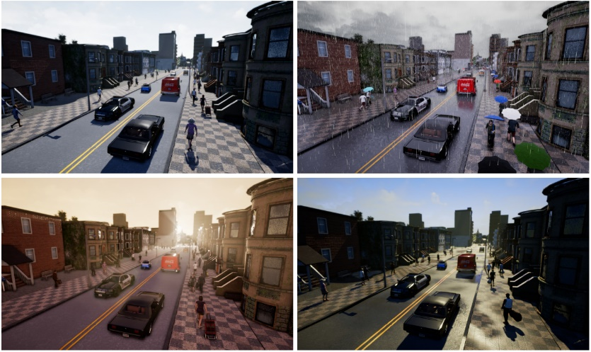
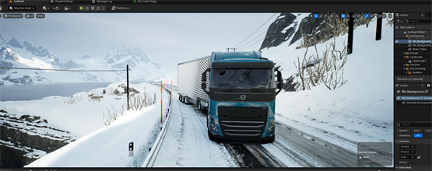


Stochastic MPC for Autonomous Vehicles in Uncertain Situations
Students: Saeed Salih & Qun Zhang
Goal: Safe, Predictive Control that accounts for uncertainties:
Path Planning with < 10 second horizon.
Uncertainties could affect: 1. Sensing; 2. Dynamics; 3. Obstacles
Key Methods: Model Predictive Control, Chance-Constraints, Vehicle Dynamics Modelling
Fig 1. Simulations in CARLA. (a): City traffic in varying weather conditions (b): High-fidelity model of Volvo Truck.
Tools: CARLA simulation environment, ACADOS/CasADi for optimization solver, primarily programming in Python
Supervisors: Erik Börve (Chalmers/ADAS GTT)
Prof. Nikolce Murgovski (Chalmers E2)
Prof. Leo Laine (Chalmers M2/SED GTT)
Fig 2. Illustration of a complex traffic scenario with an HVC

Slide 2


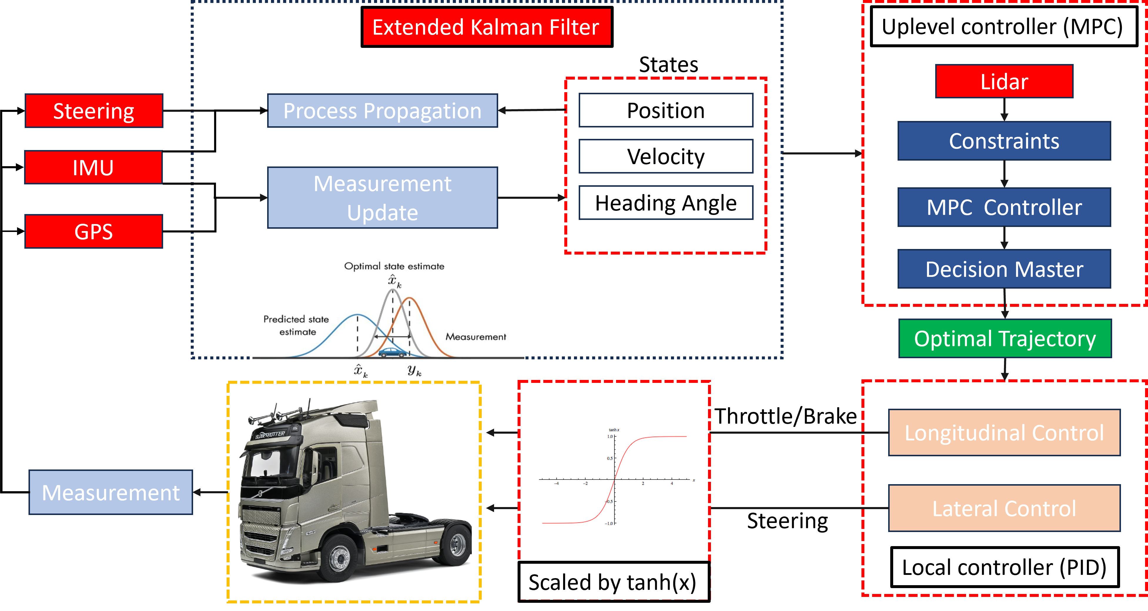
Architecture

Slide 3
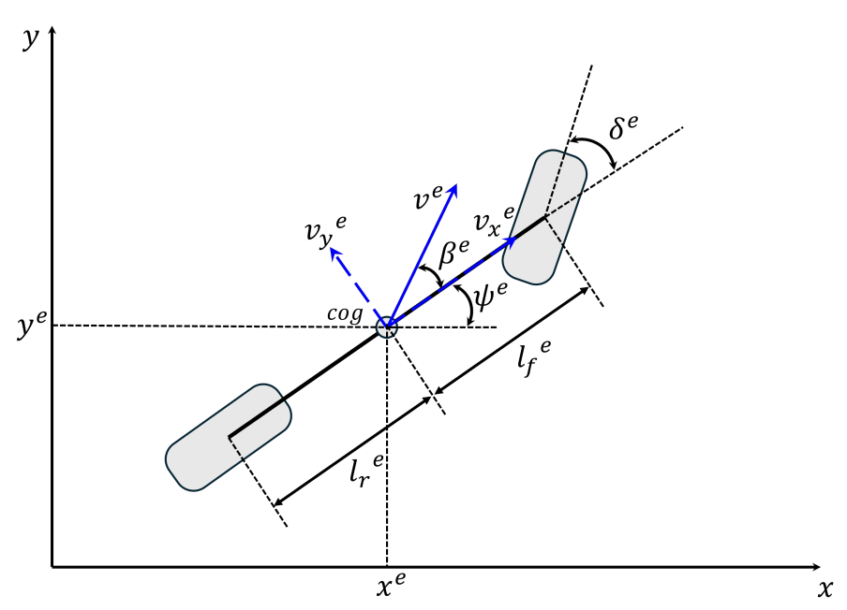
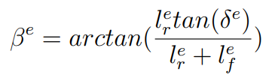
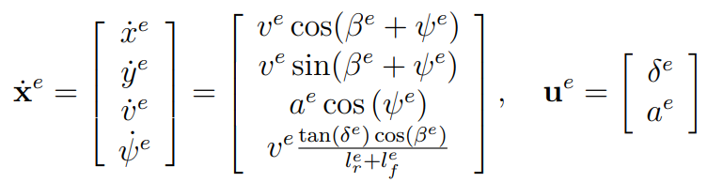
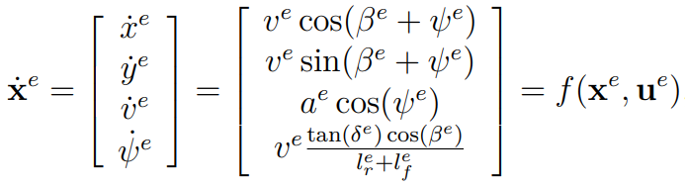
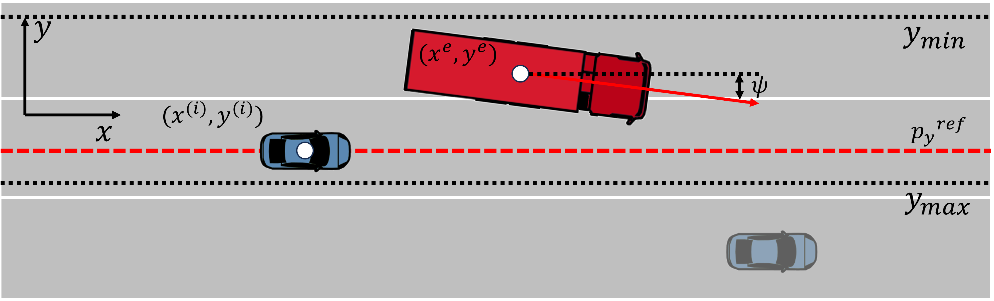
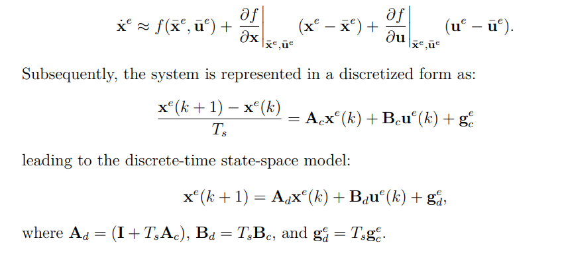
Vehicle Modeling (Kinematic model)
Kinematic model(COG):
Linearization and Discretization:

Slide 4
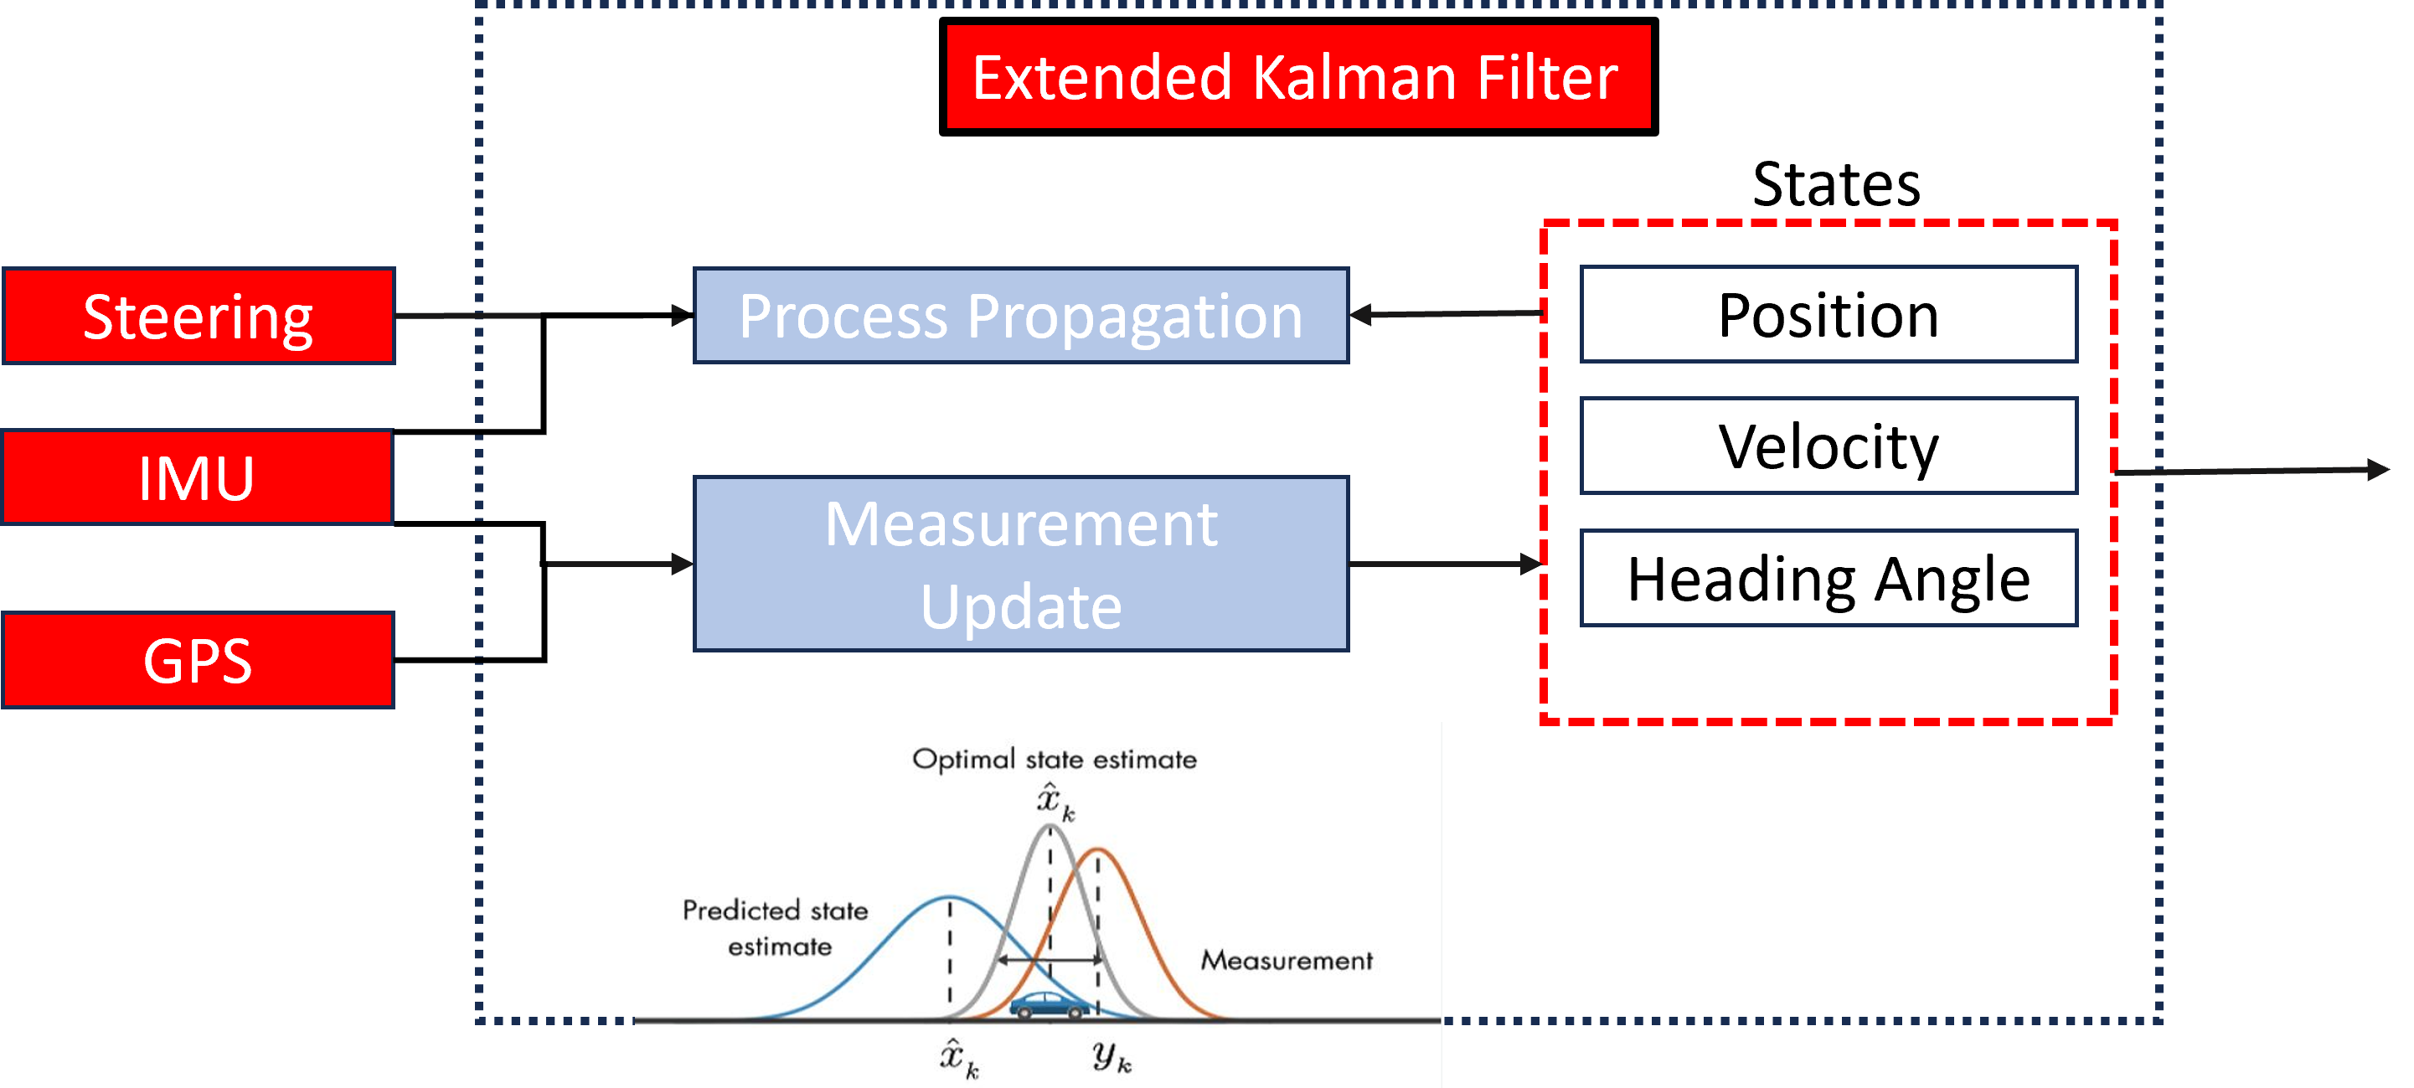
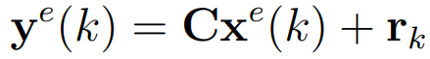
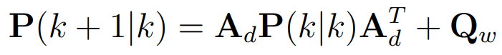
Estimator Design
Process Model:
Measurement Model:
Prediction Process:
Update Process:

Slide 5
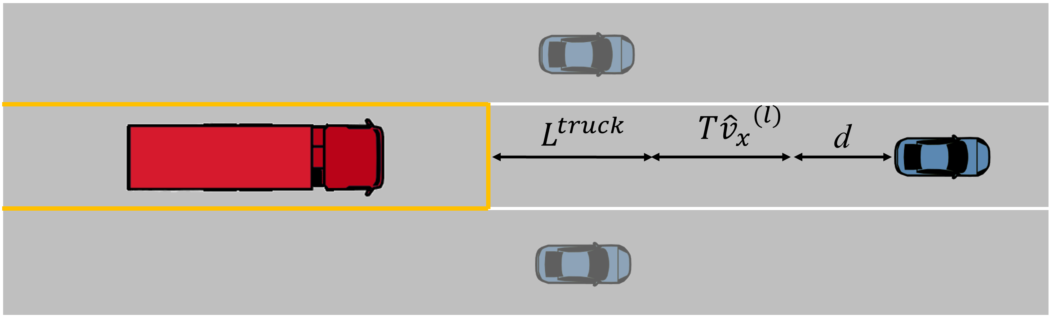
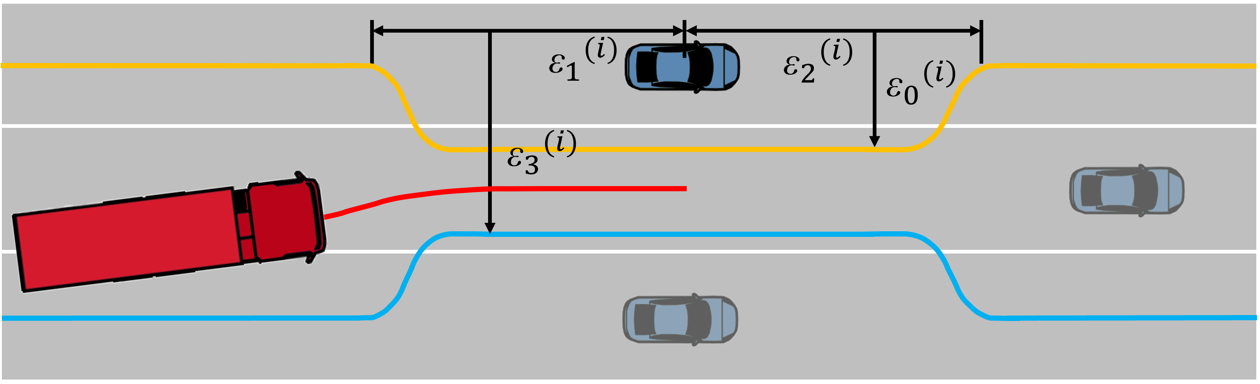
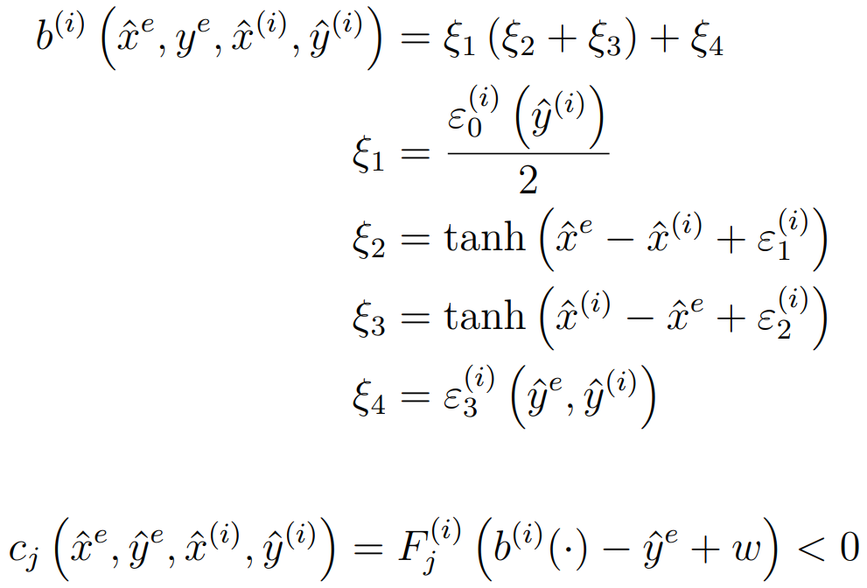
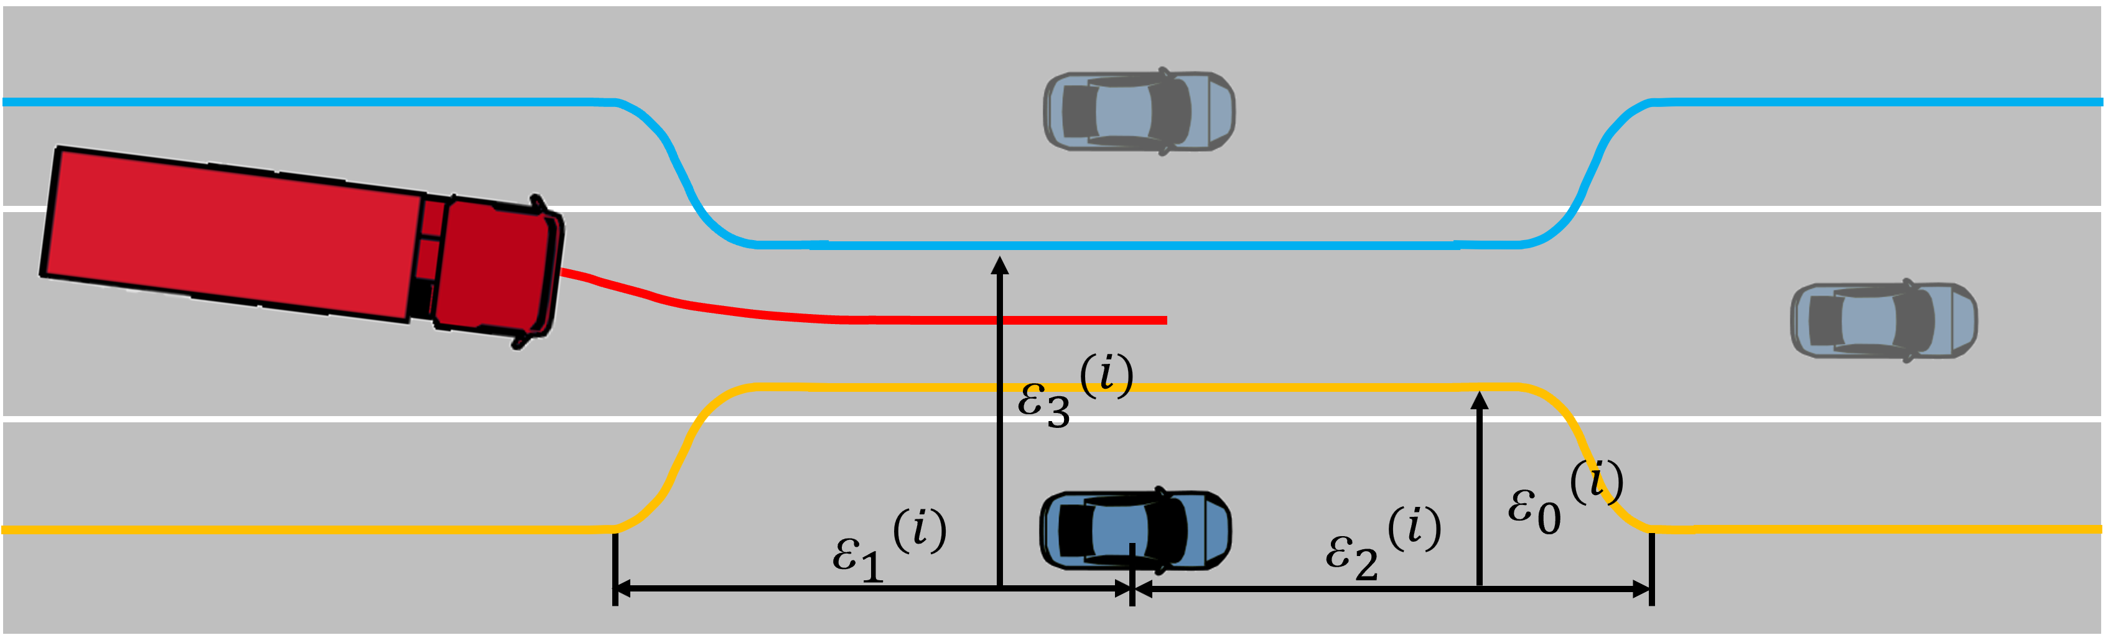
MPC Controller Constraints
Trailing Constraints:
Initial Constraints:
Constraints with slack variable:
Lane changing Constraints:
Initial Constraints:
Constraints with slack variable:

Slide 6
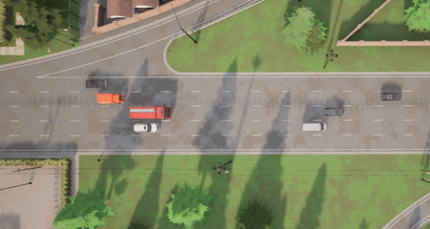
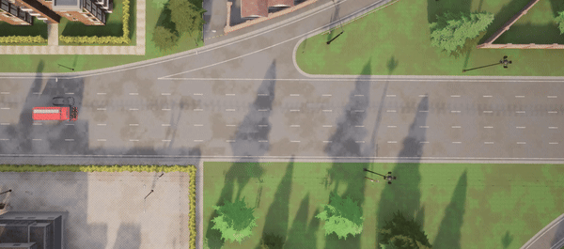
MPC Controller Constraints
Trailing Controller
Left Lane Change Controller
Right Lane Change Controller
The Trailing Controller operates within the boundaries set by Intelligent Driver Model (IDM) constraints.
The Lane Change Controllers adhere to limits through a smooth approximation using tanh functions.

Slide 7
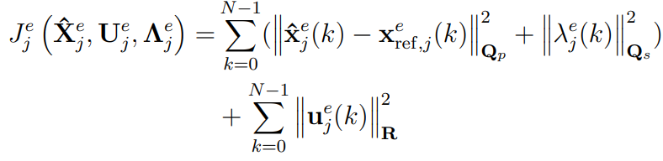
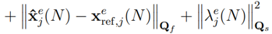
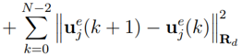
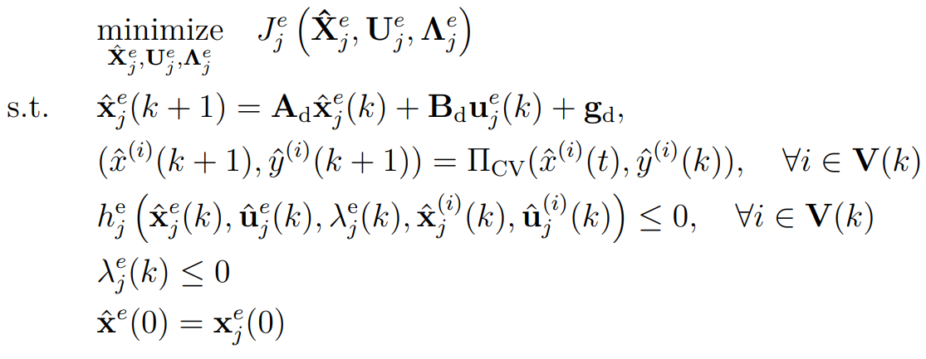
Optimal Control Problem Formulation
The cost function aims to track the trajectory while minimizing the control input and the change of the input. It also needs to satisfy traffic constraints predicted by the CV model and its own system limitations.

Slide 8
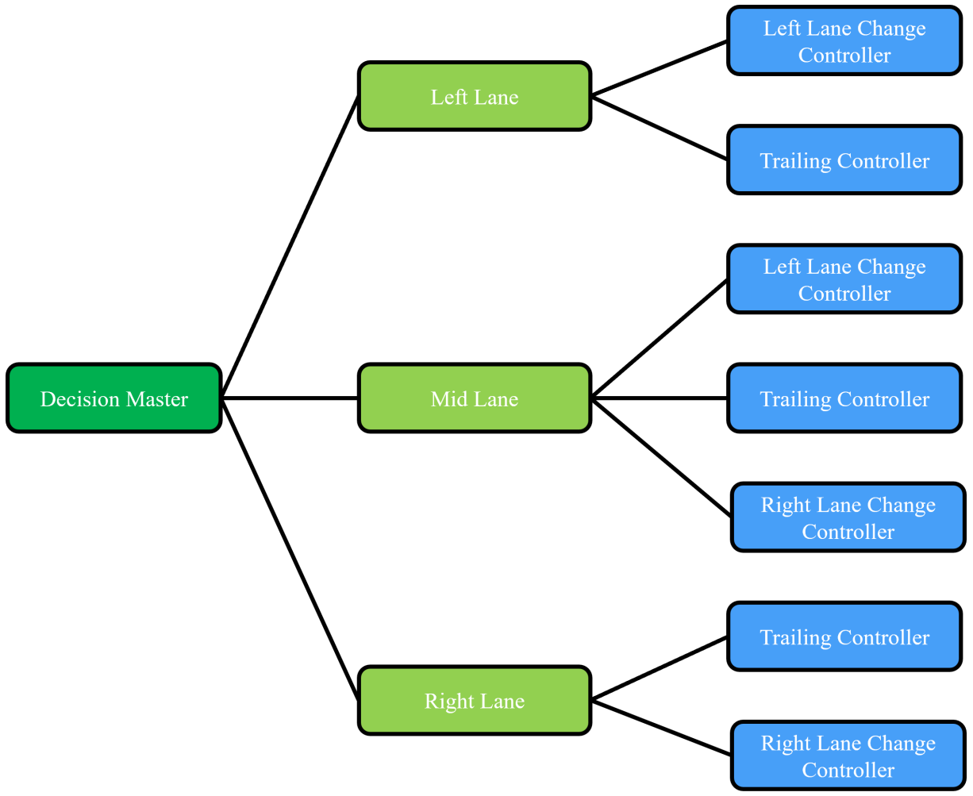
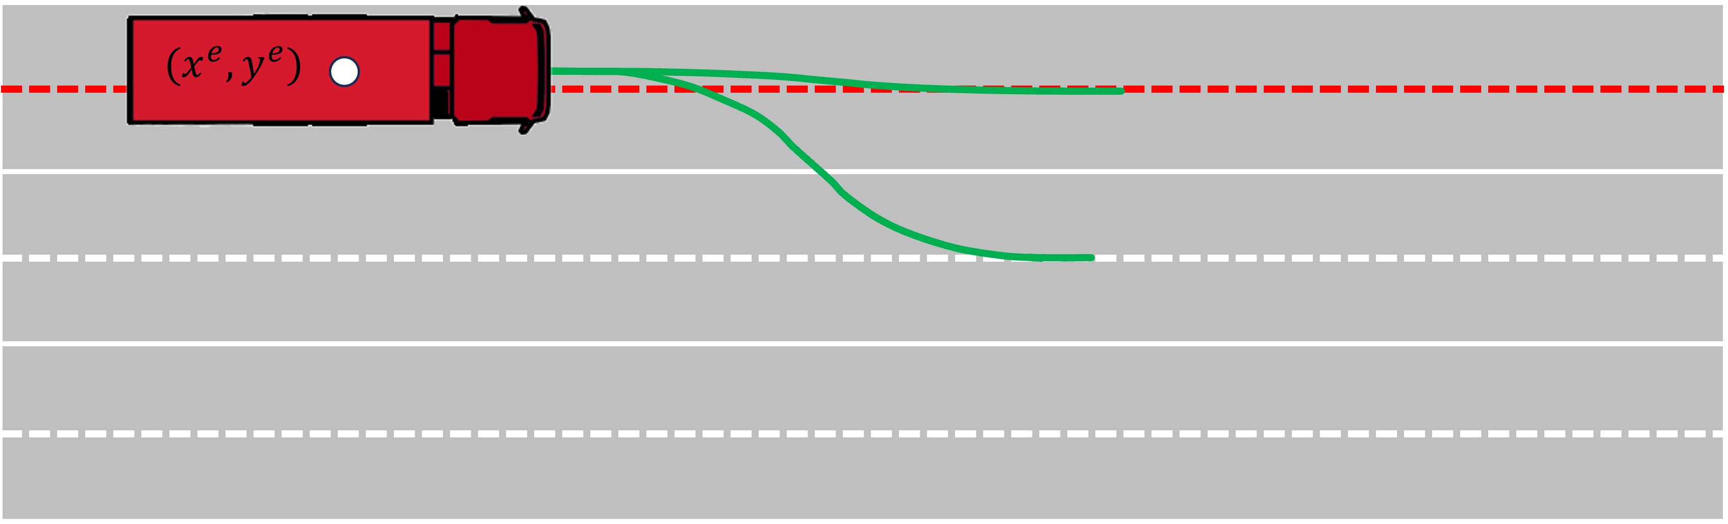
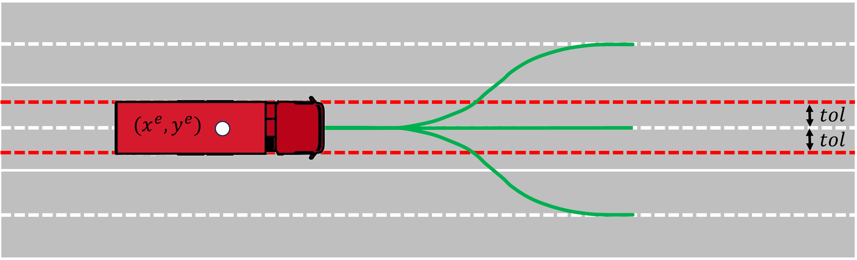
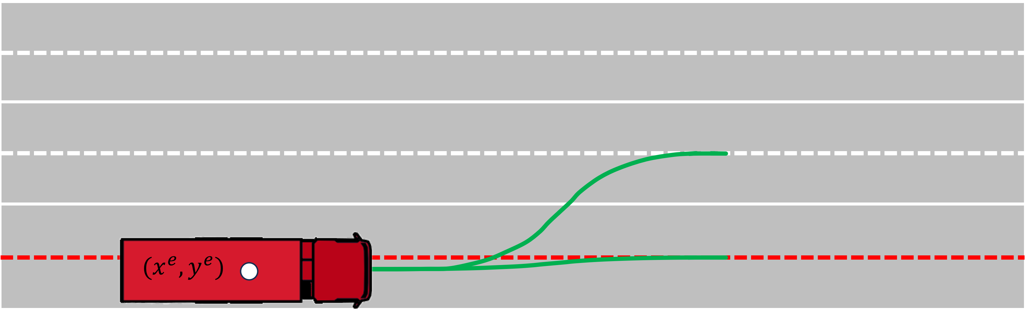
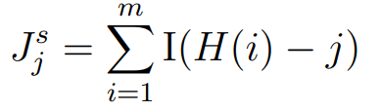
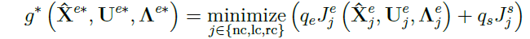
Decision Master
The DM is responsible for selecting controllers and references for different scenarios. In addition, the decision function g selects the optimal control sequence based on the following criterion:

Slide 9
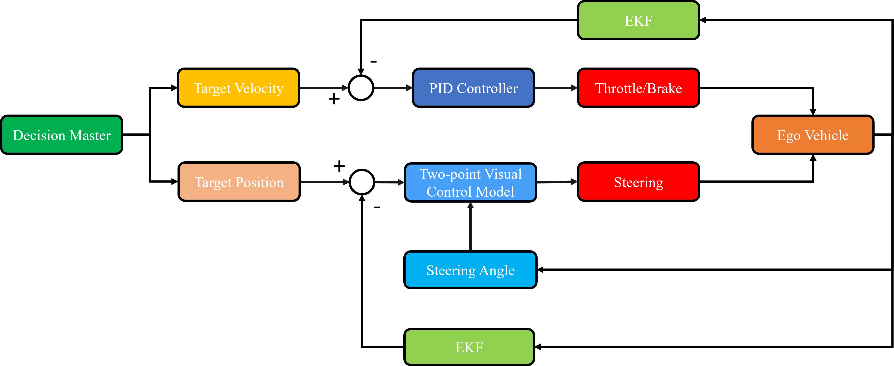
Local Controller

Slide 10
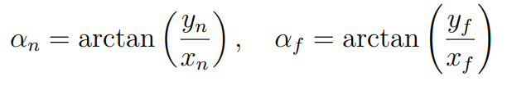
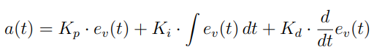
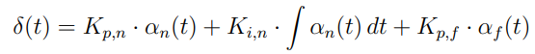
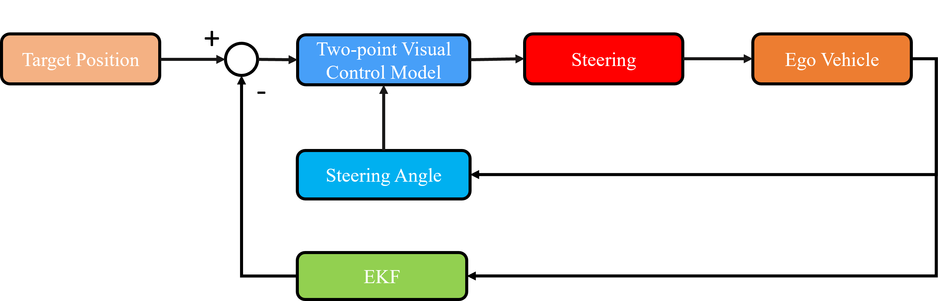
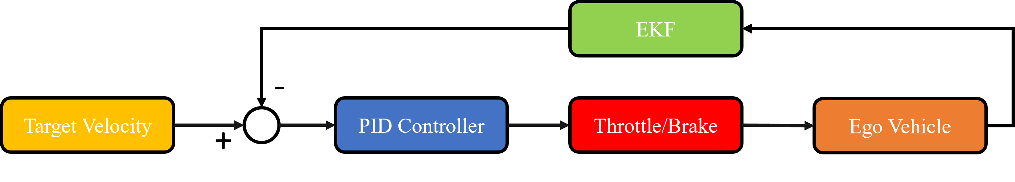
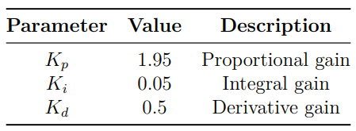
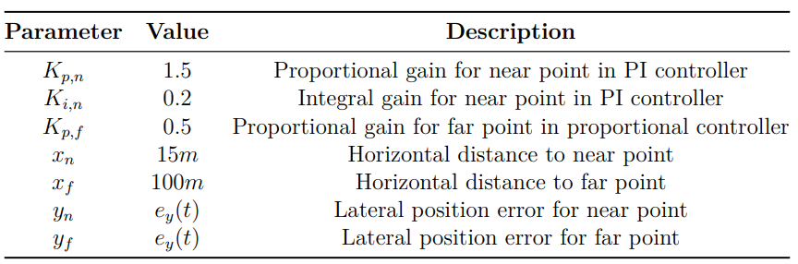
Longitudinal Control
Lateral Control

Slide 11
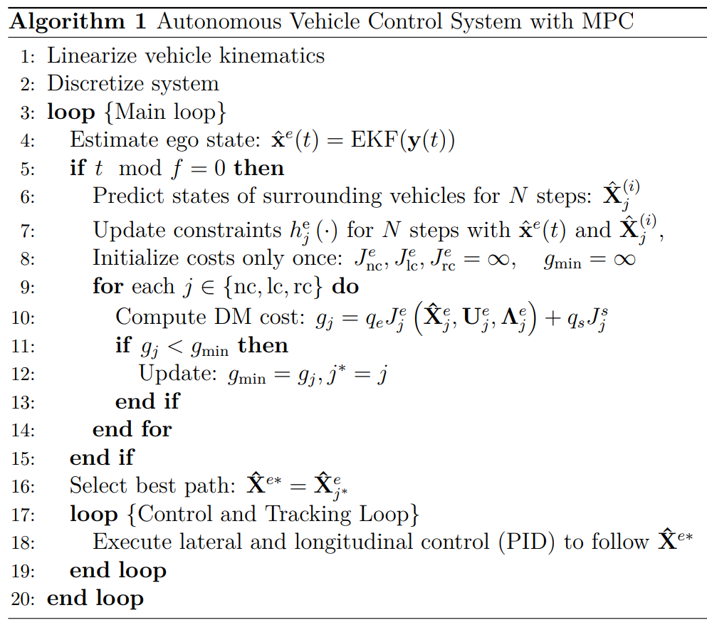
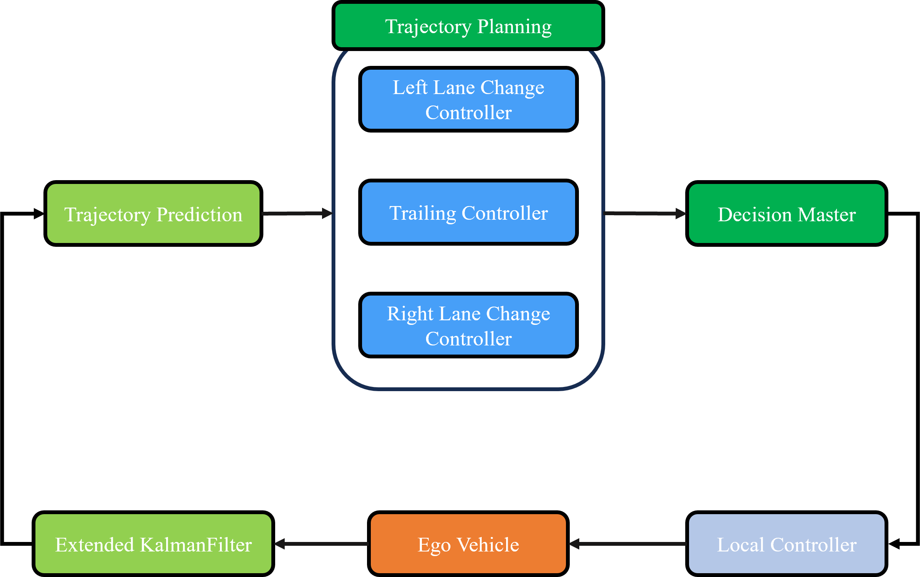
MPC Framework

Slide 12
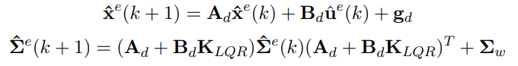
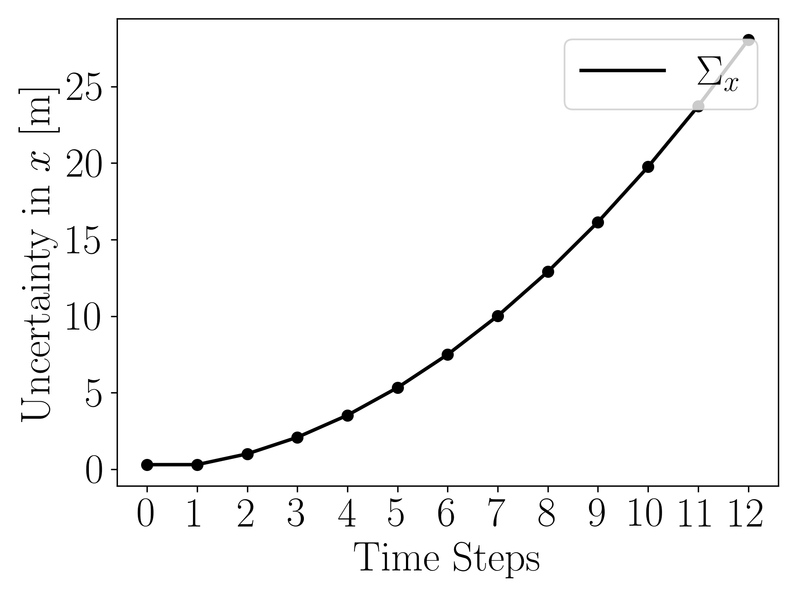
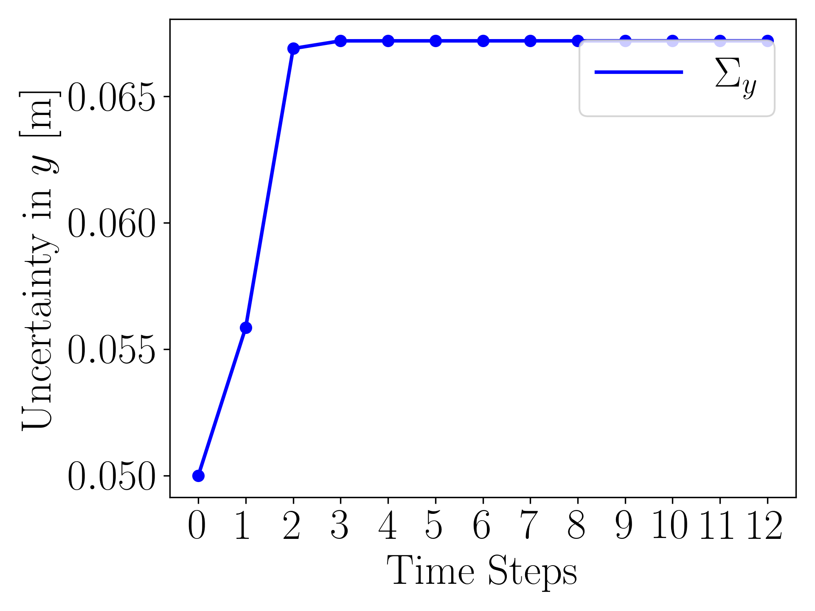
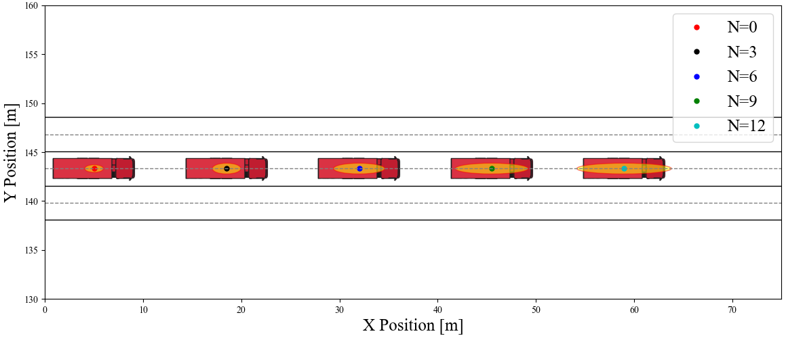
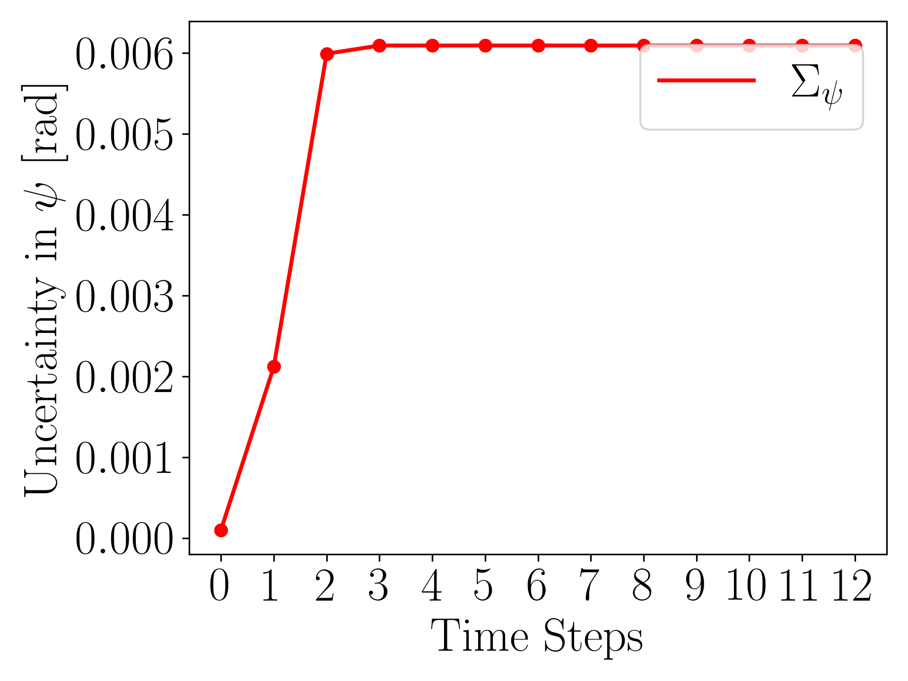
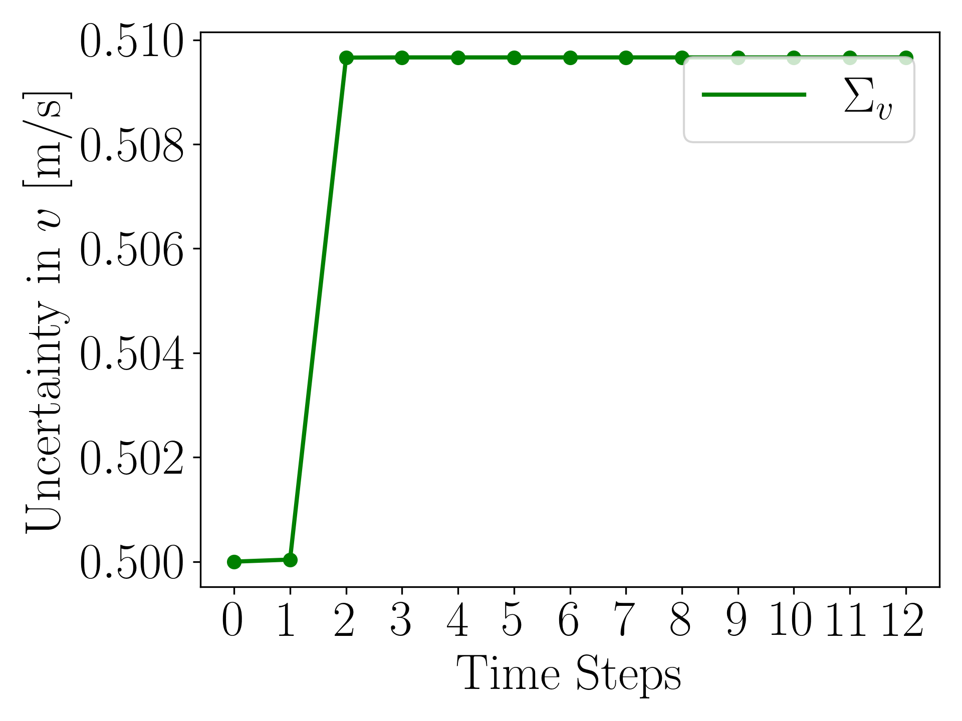
Theoretical Foundations of SMPC
Theoretical Foundations of Stochastic Model Predictive Control
As time progresses, the influence of noise on the system escalates, significantly affecting the positioning accuracy of the ego vehicle. Despite the application of feedback gain, the system's uncertainty continues to increase, impacting the control effectiveness.

Slide 13
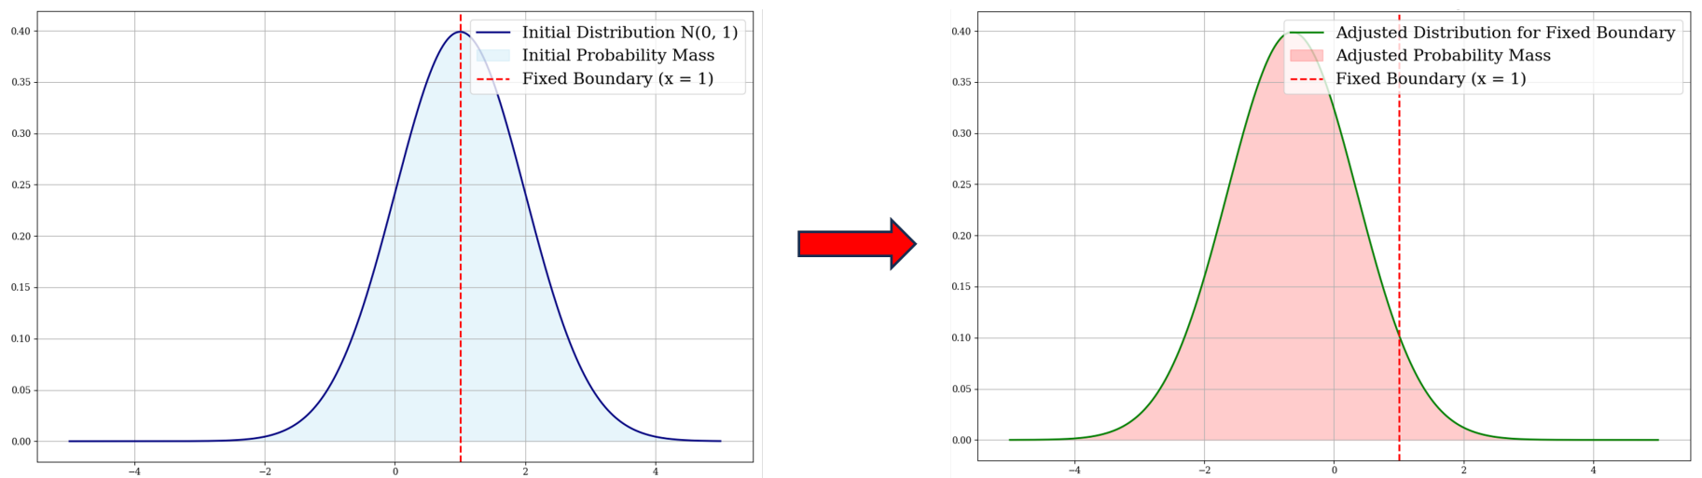
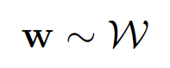
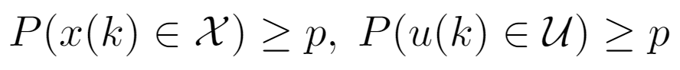
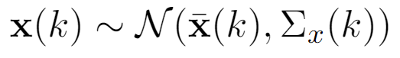
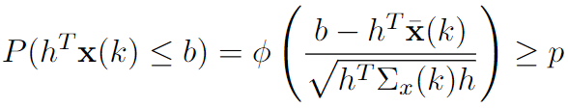
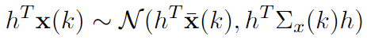






Theoretical Foundations of SMPC
Stochastic​ MPC Settings
Uncertainty follows some i.i.d distribution
Constraints are satisifed with some probabilty
Soft constraints guarentees, violation can happen, but are unlikely (Chance-Constraints).
Why use Stochastic​ MPC
Always accounting for very unlikely scenarios can yield poor performance.
Note:
$φ^{−1}(p)$ is a constant. Possibility $(p)$ here is 0.95
$Σ_{x}\left(k\right)$ and feedback gain can be pre-computed to avoid non-convex issue
We can trade off risk and performance by tuning constraint satisfaction level ($p$).
Explicitly treating violations → ’’graceful’’ recovery

Slide 14





SMPC Controller Constraints
State and Input Constraints:
Trailing Constraints:
Initial Constraints:
Constraints with SMPC:
Lane changing Constraints:
Initial Constraints:
Constraints with SMPC:

Slide 15








SMPC Controller Constraints

Slide 16




Optimal Control Problem Formulation
By incorporating uncertainty, new tightened constraints are generated, resulting in the updated SMPC cost function. The vehicle controlled by this updated SMPC anticipates potential issues and adjusts its trajectory accordingly.

Slide 17

SMPC Framework

Slide 18

Testing Environment in CARLA

Slide 19




Decision Process Comparison
Decision Process at iteration 10 (MPC):
Decision Process at iteration 10 (SMPC):
Decision Process at iteration 20 (MPC):
Decision Process at iteration 20 (SMPC):

Slide 20




Test in the Heavy Traffic Scenario
MPC ：
SMPC ：

Slide 21


Test in the Heavy Traffic Scenario

Slide 22


Test in Random Traffic Scenarios
In the 100 randomized tests we conducted, the self-vehicle with the SMPC strategy collided in very few cases, with a collision rate of only 1% (only 1 collision). In contrast, the self-vehicle with the standard MPC strategy had 5 collisions with a collision rate of 5%.

Slide 23
Thank You
Q & A

